Slide 1
Deep Learning with S-shaped Rectified Linear Activation Units
Andrea Lombardo
Luca Tomei

Slide 2
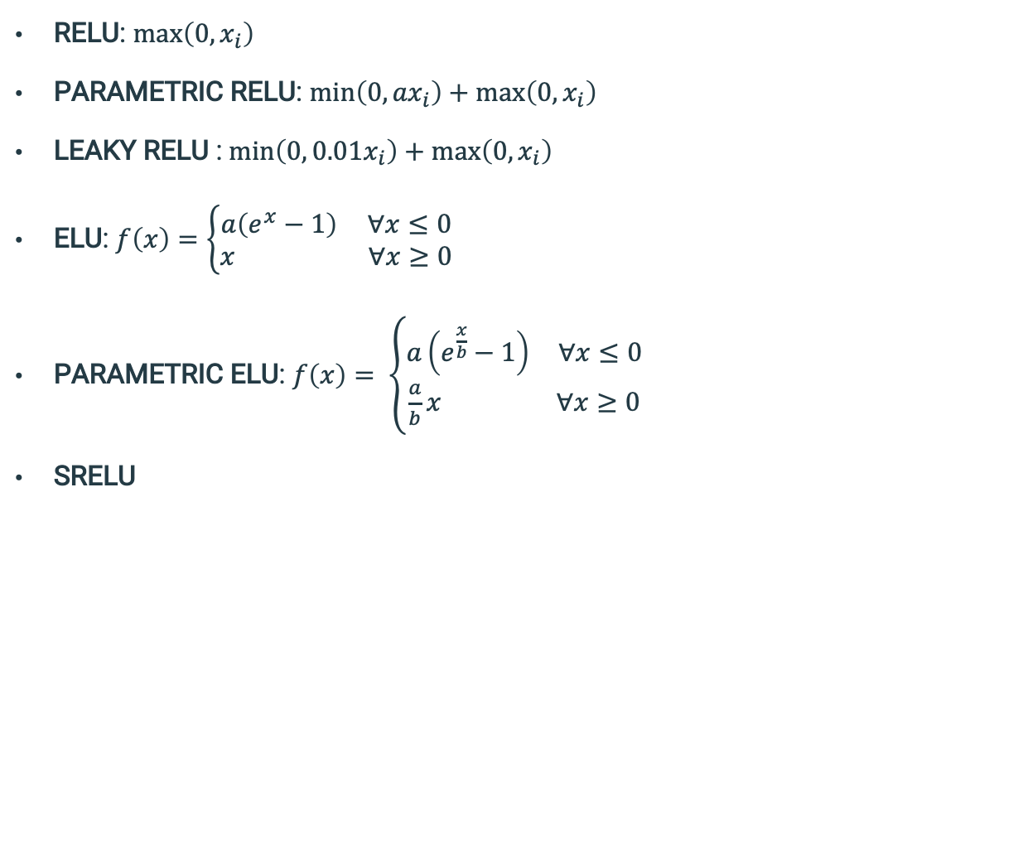
USED ACTIVATION FUNCTIONS
RELU: $\max\left(0, x_{i}\right)$
PARAMETRIC RELU: $\min\left(0, {ax}_{i}\right)+\max\left(0, x_{i}\right)$
LEAKY RELU : $\min\left(0, {0.01x}_{i}\right)+\max\left(0, x_{i}\right)$
ELU: $f\left(x\right)=\left\{\begin{aligned}a\left(e^{x}−1\right) ∀x≤0 \\ x ∀x≥0\end{aligned}\right.$
PARAMETRIC ELU: $f\left(x\right)= \left\{\begin{aligned}a\left(e^{\frac{x}{b}}−1\right) ∀x≤0 \\ \frac{a}{b}x ∀x≥0\end{aligned}\right.$
SRELU

Slide 3
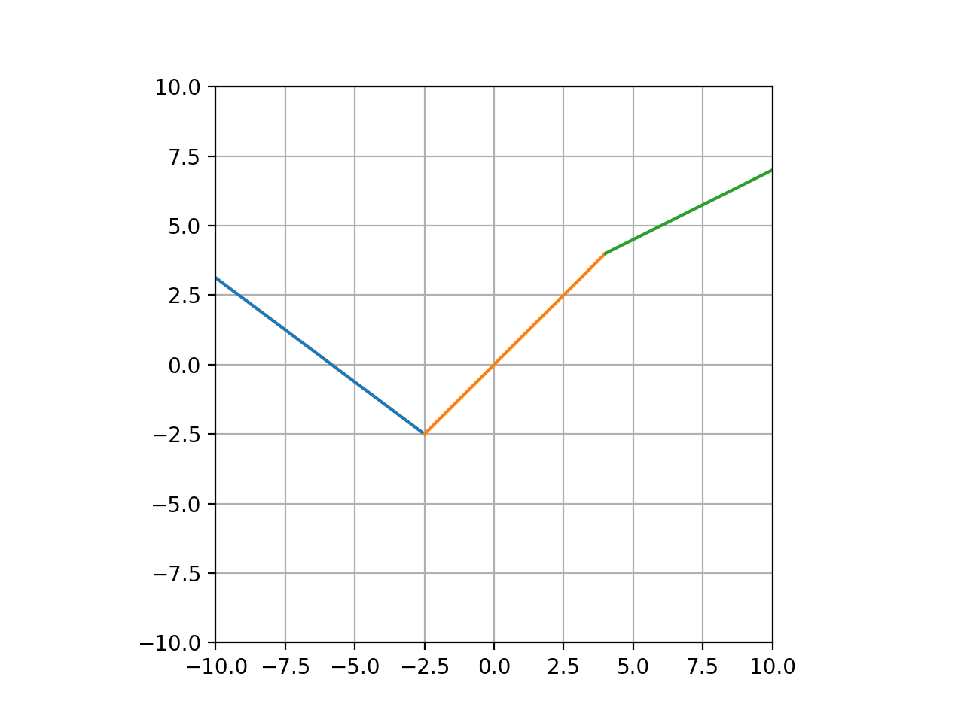
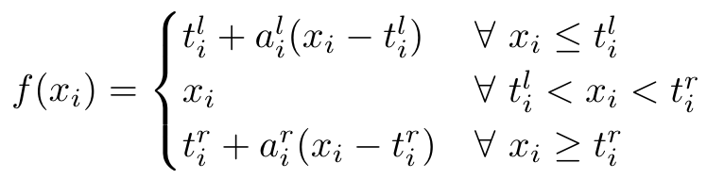
INTRODUCTION OF THE SRELU FUNCTION
S-shaped Rectified Linear Unit

Slide 4
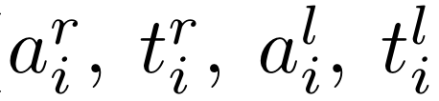
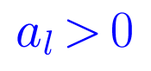
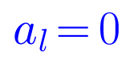
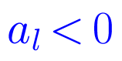
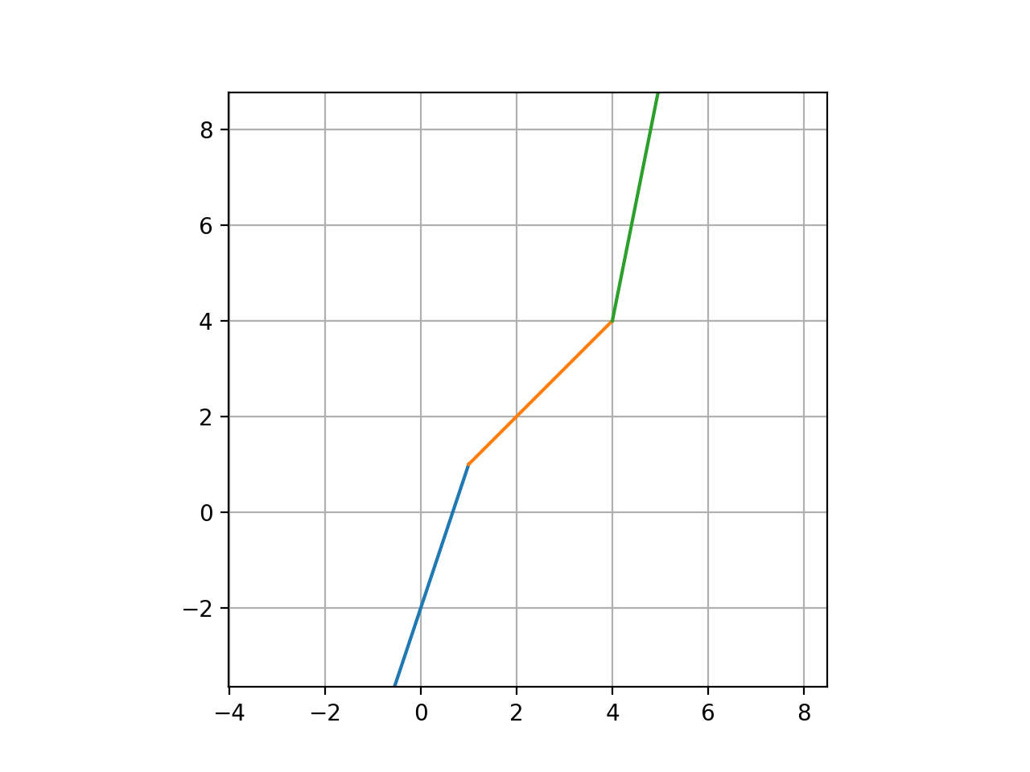
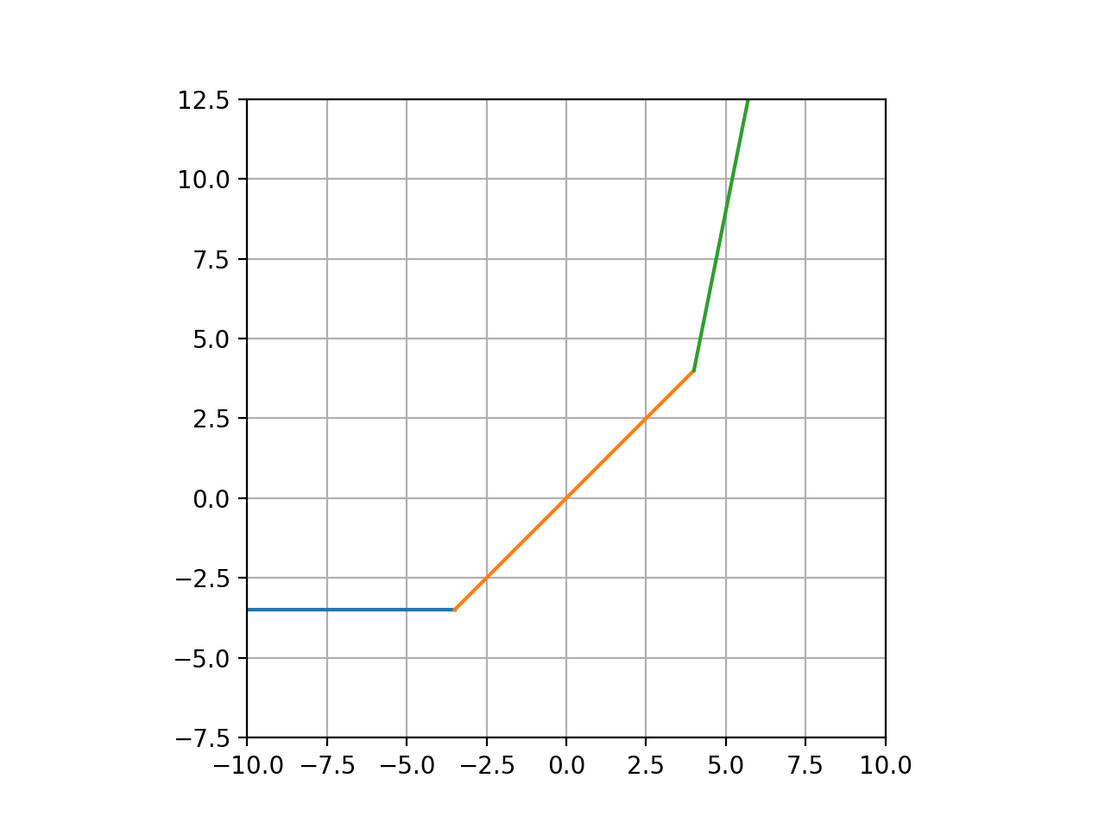
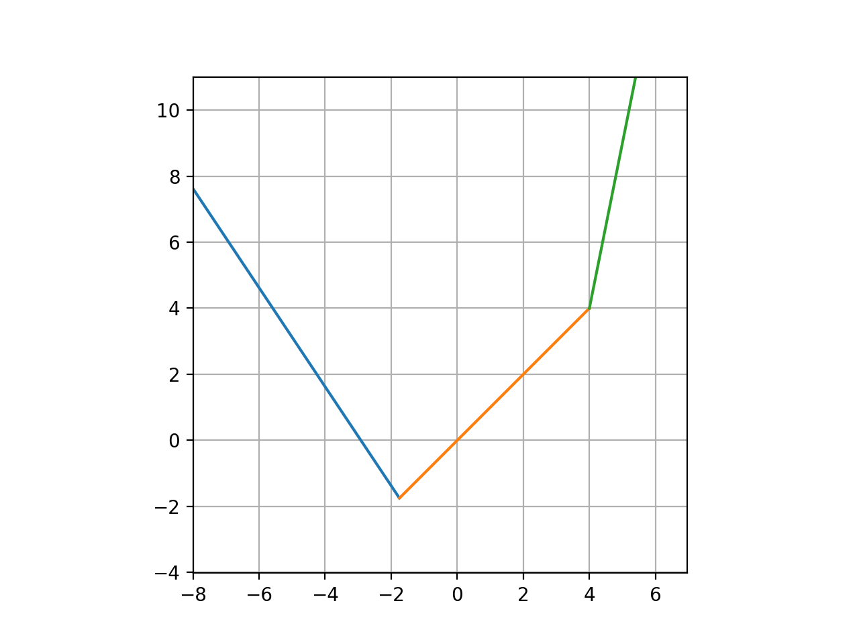
PROPERTIES OF THE SRELU FUNCTION
The SReLU activation function has some remarkable properties:
It has four trainable parameters:

Slide 5
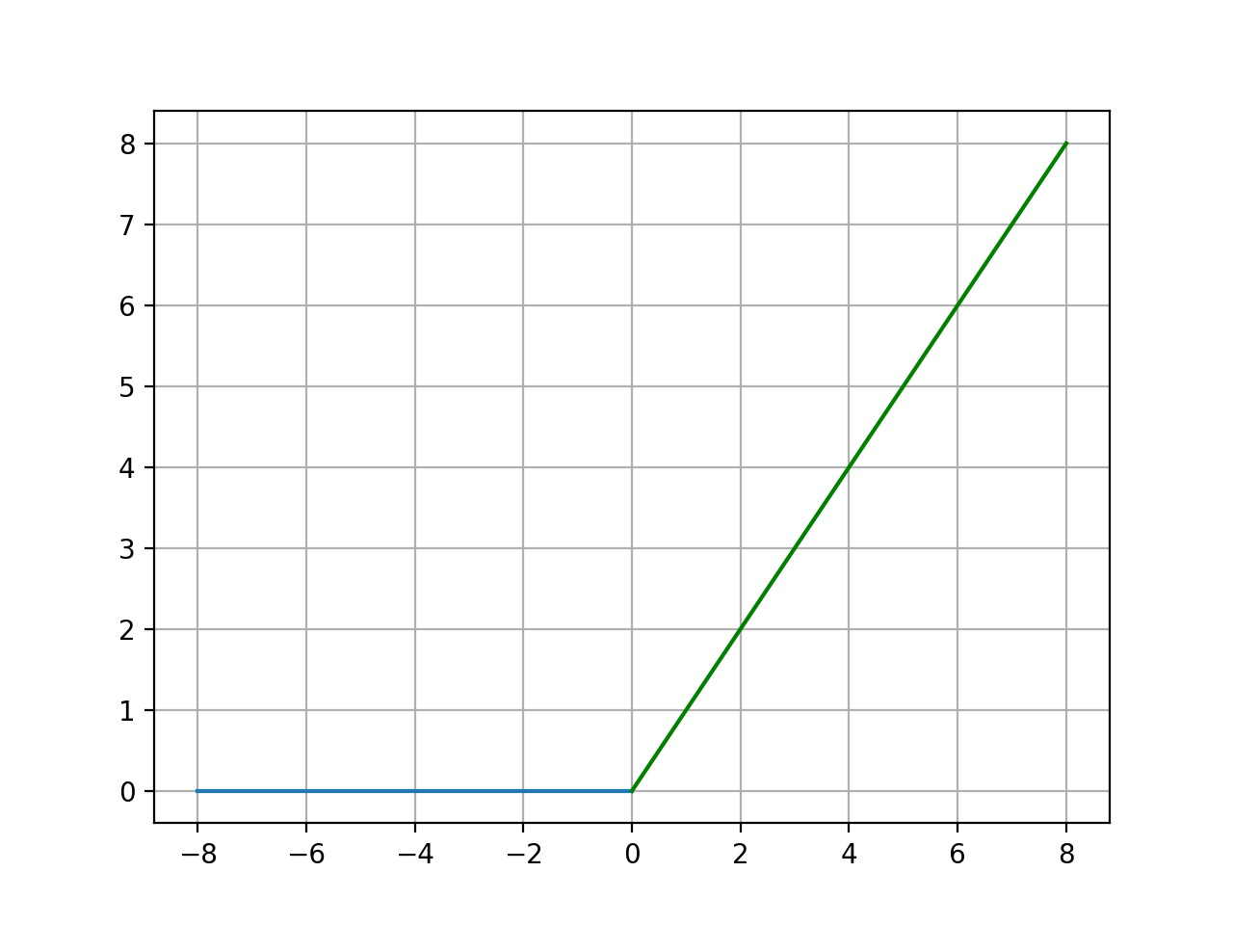
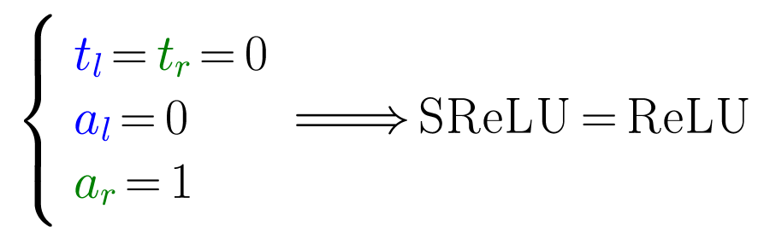
PROPERTIES OF THE SRELU FUNCTION
The SReLU activation function has some remarkable properties:
It generalizes the ReLU function:

Slide 6
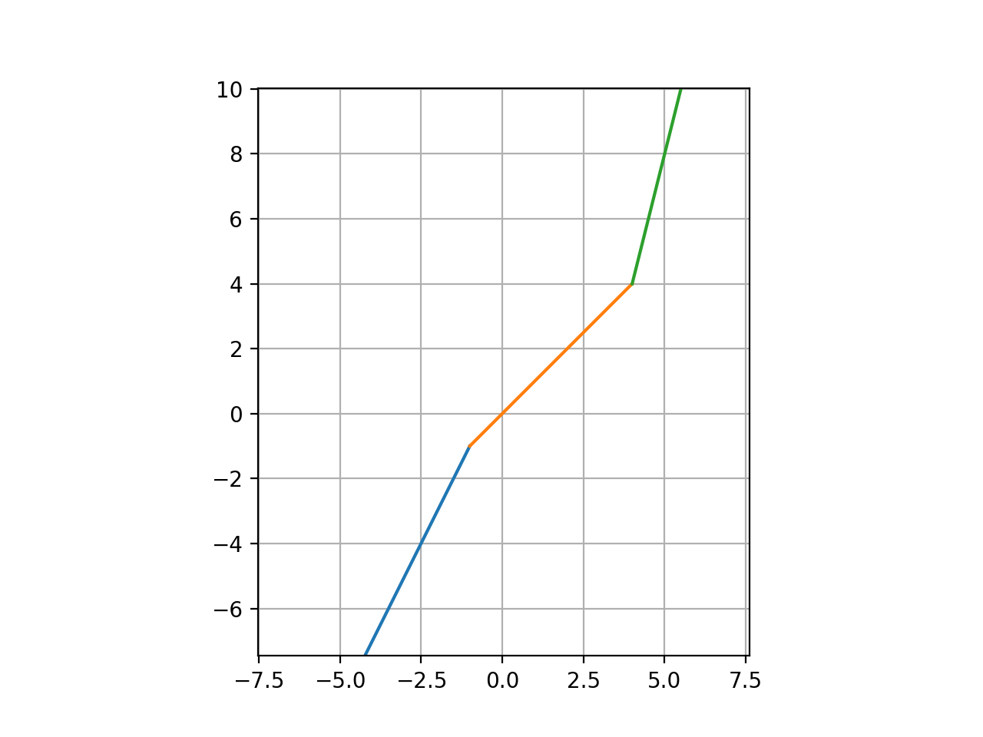
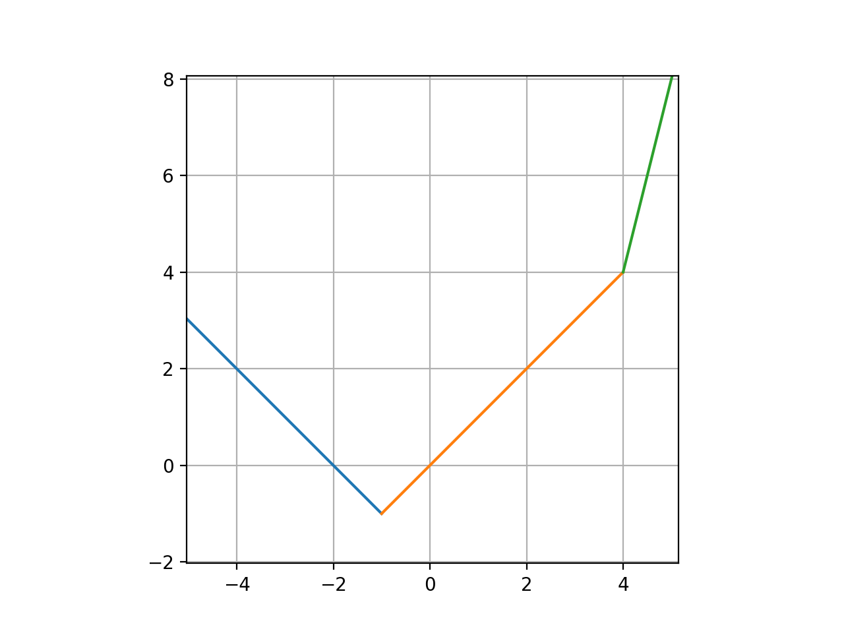
PROPERTIES OF THE SRELU FUNCTION
The SReLU activation function has some remarkable properties:
It can be settled to be either convex or non-convex:

Slide 7
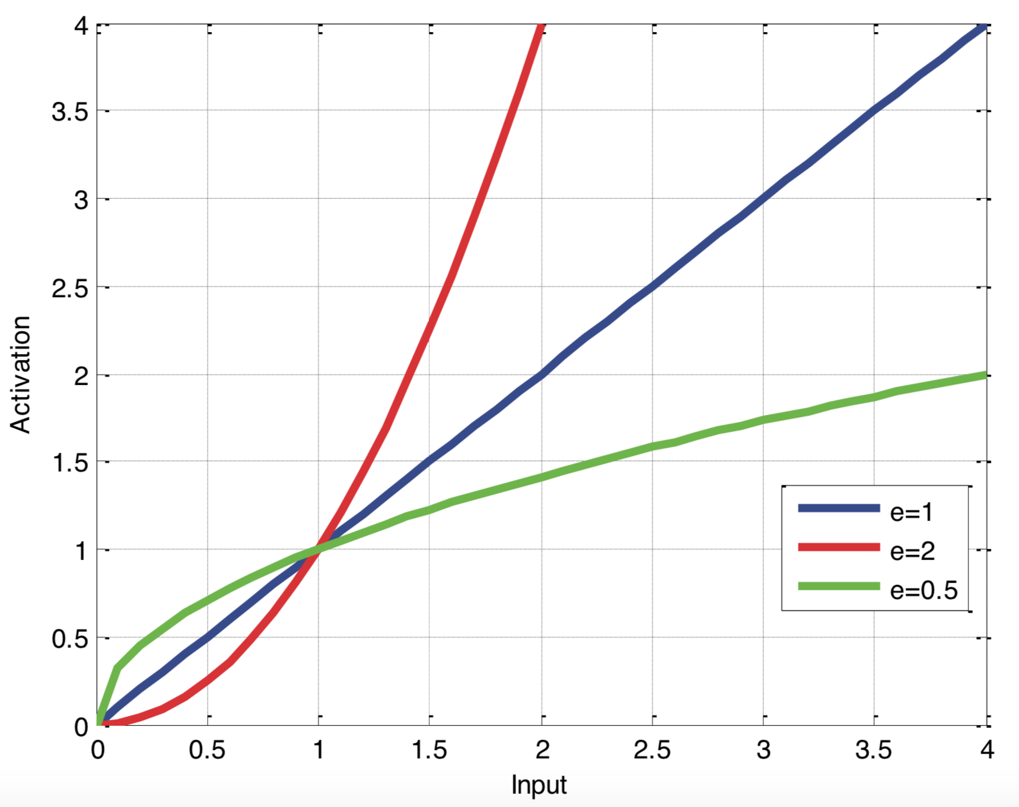
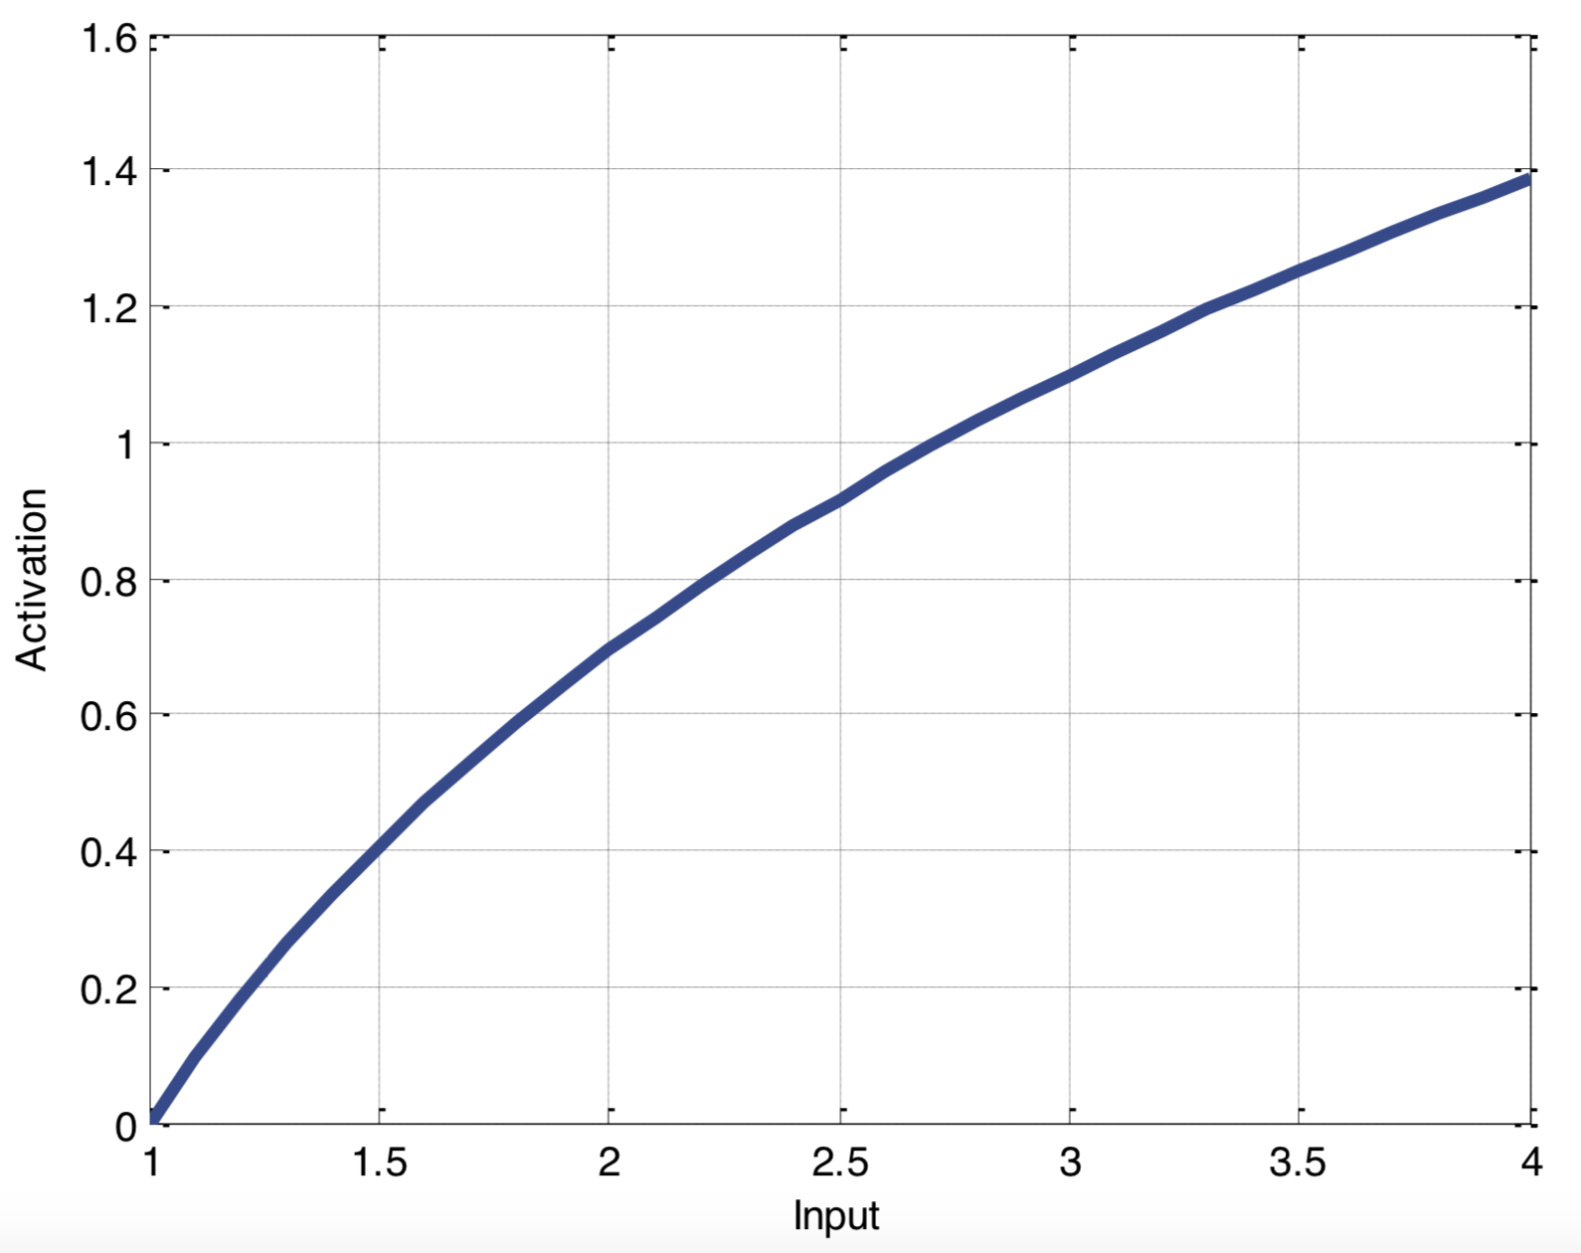
PROPERTIES OF THE SRELU FUNCTION
The SReLU activation function has some remarkable properties:
It can be settled to emulate the human perception mechanisms:

Slide 8
EXPERIMENTAL SETTINGS

Slide 9
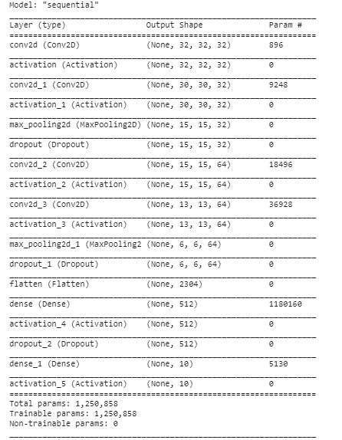
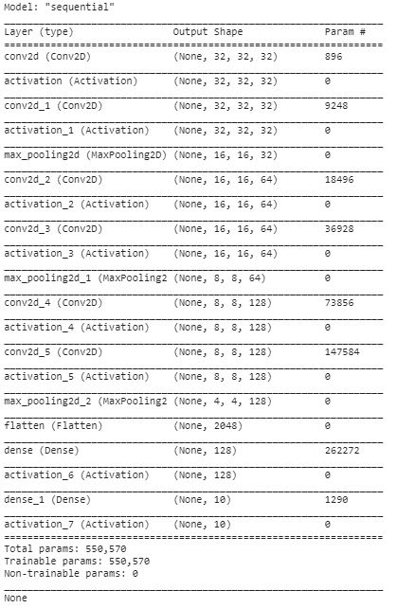
IMPLEMENTED ARCHITECTURES ON CIFAR10
CNN 1
CNN 2

Slide 10
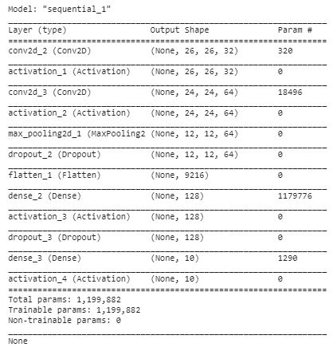
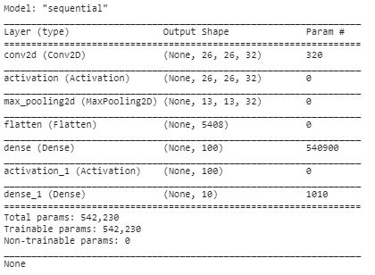
IMPLEMENTED ARCHITECTURES ON MNIST
CNN 1
CNN 2

Slide 11
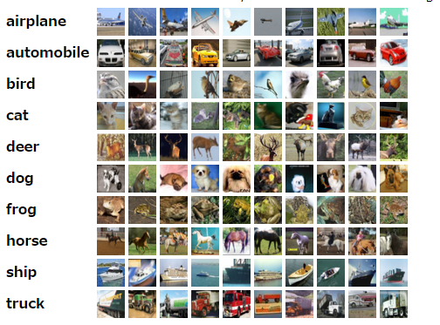

DATASETS
CIFAR10
MNIST

Slide 12
IMPLEMENTATION DETAILS

Slide 13
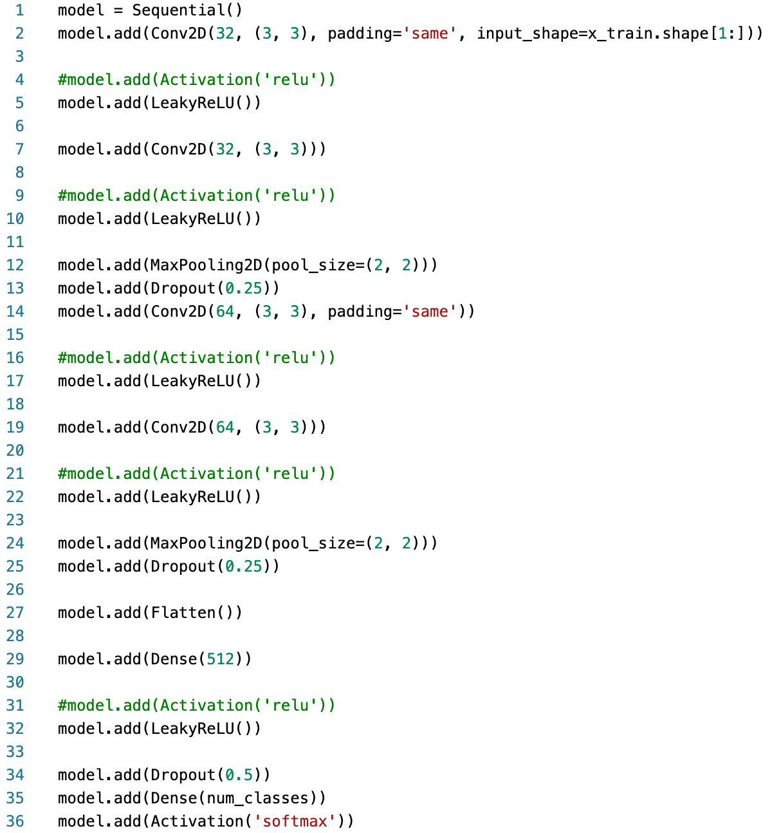
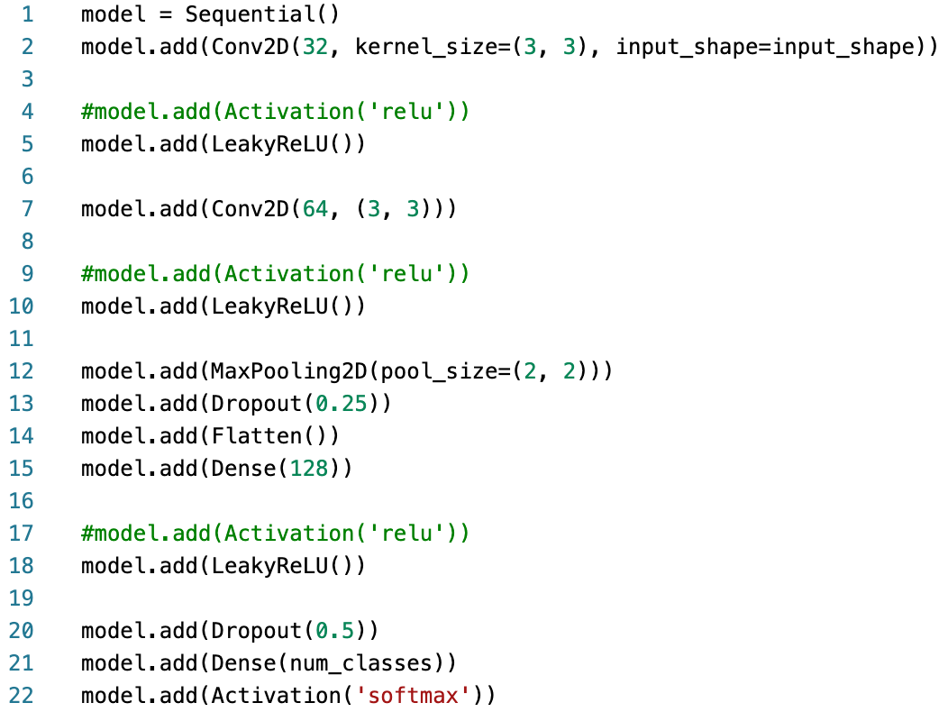
NEURAL NETWORKS IMPLEMENTATION
CNN1 on CIFAR10
CNN1 on MNIST

Slide 14
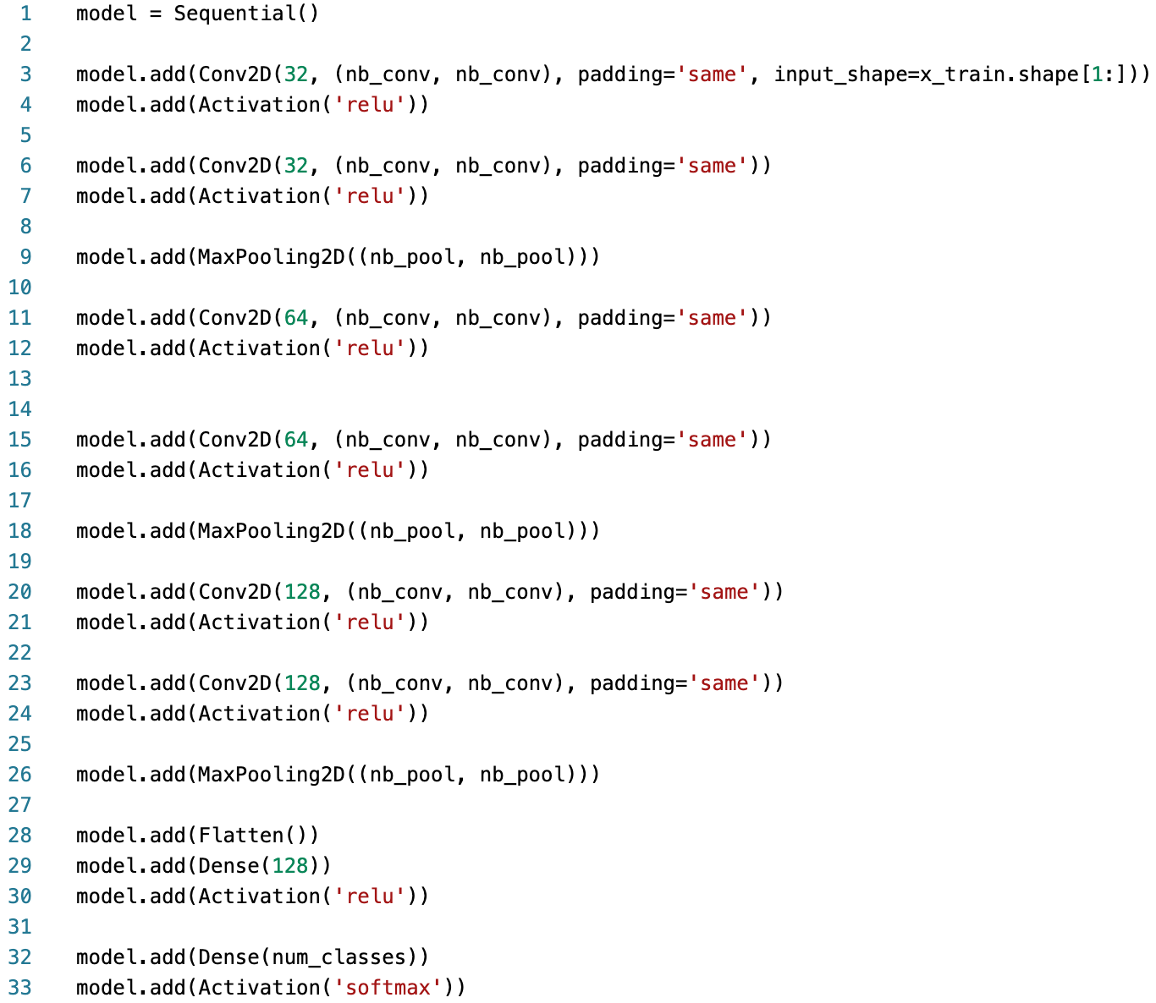
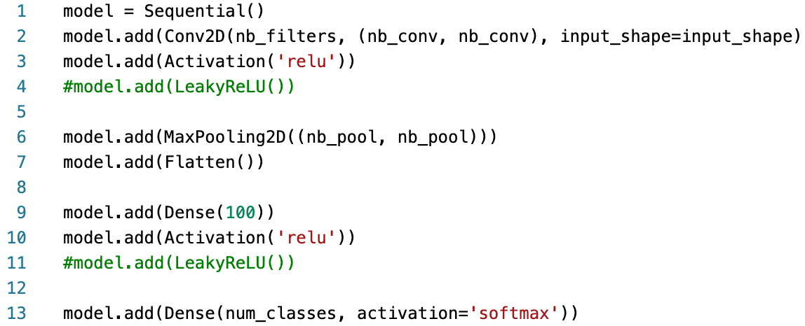
NEURAL NETWORKS IMPLEMENTATION
CNN2 on CIFAR10
CNN2 on MNIST

Slide 15
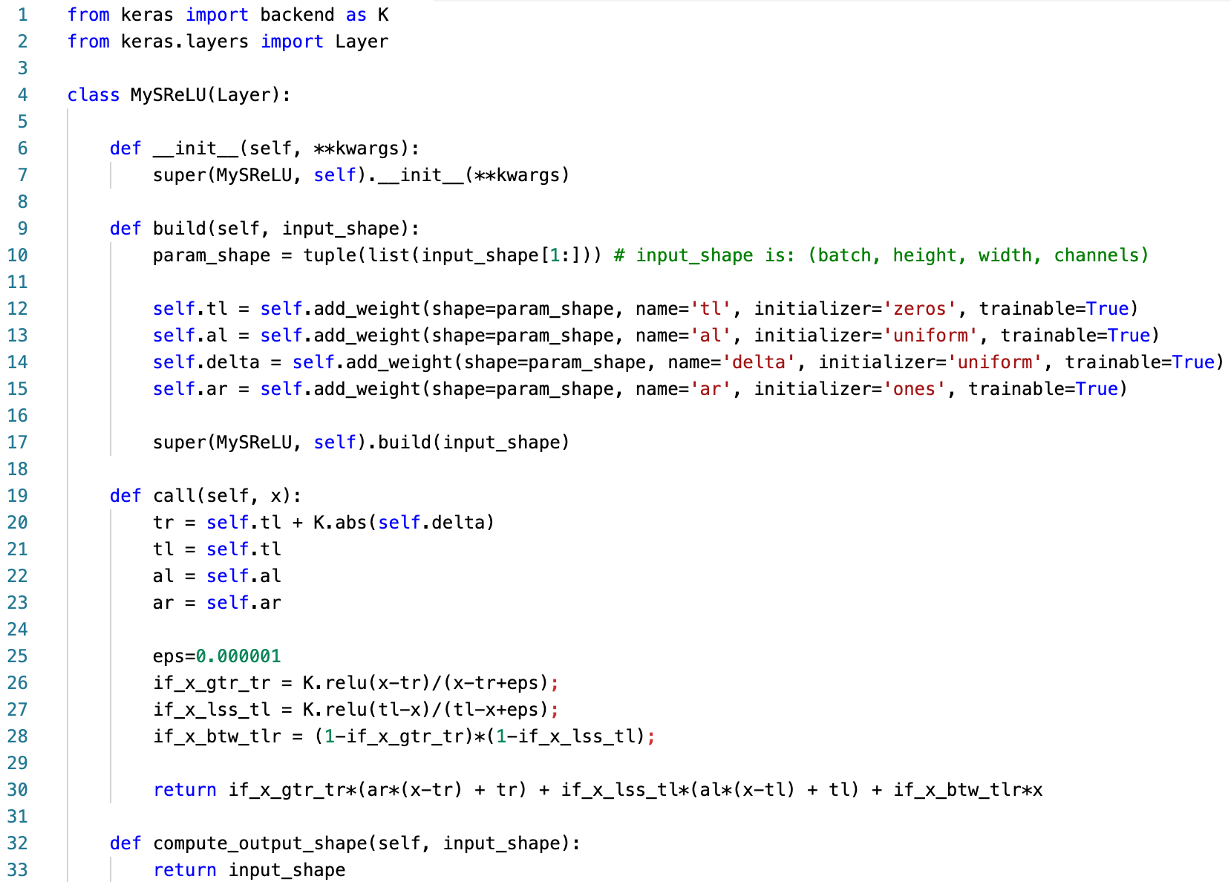
MySReLU IMPLEMENTATION

Slide 16
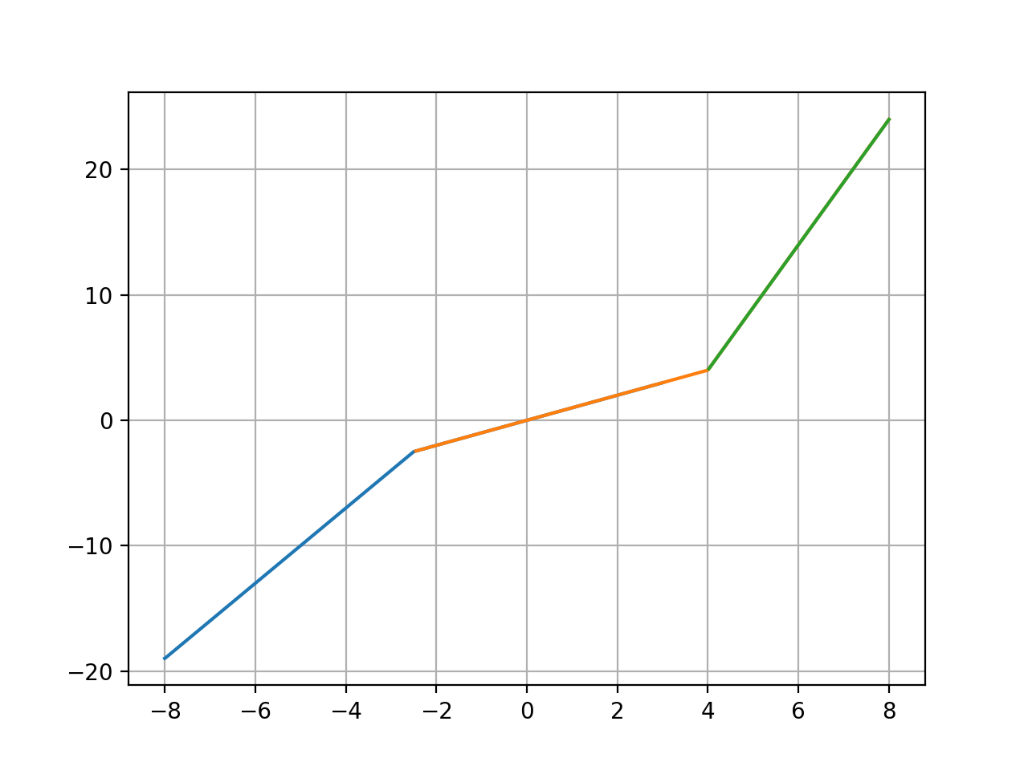
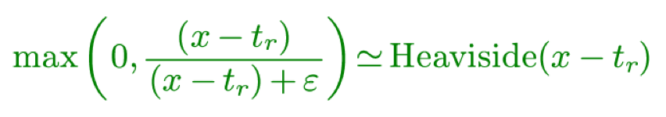
MySReLU IMPLEMENTATION
t_{l}
t_{r}

Slide 17
RESULTS

Slide 18
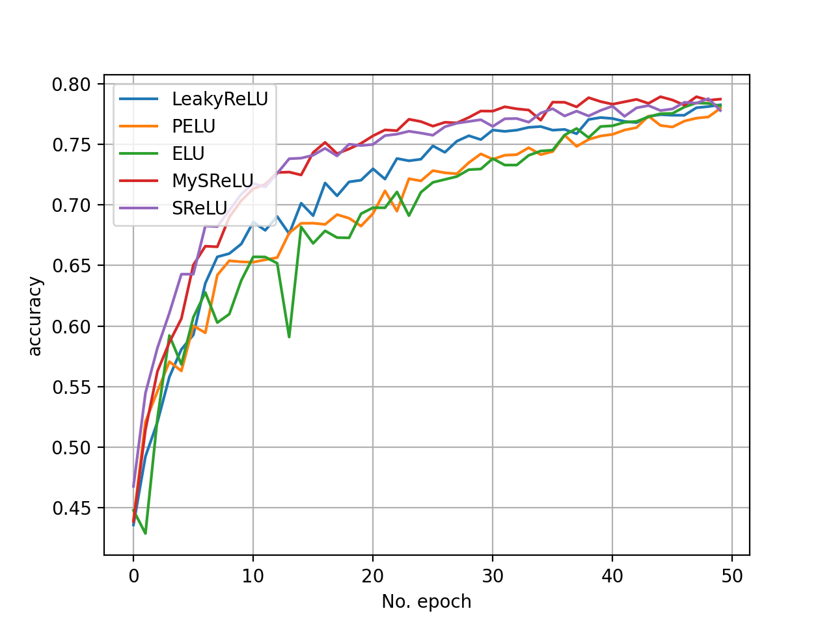
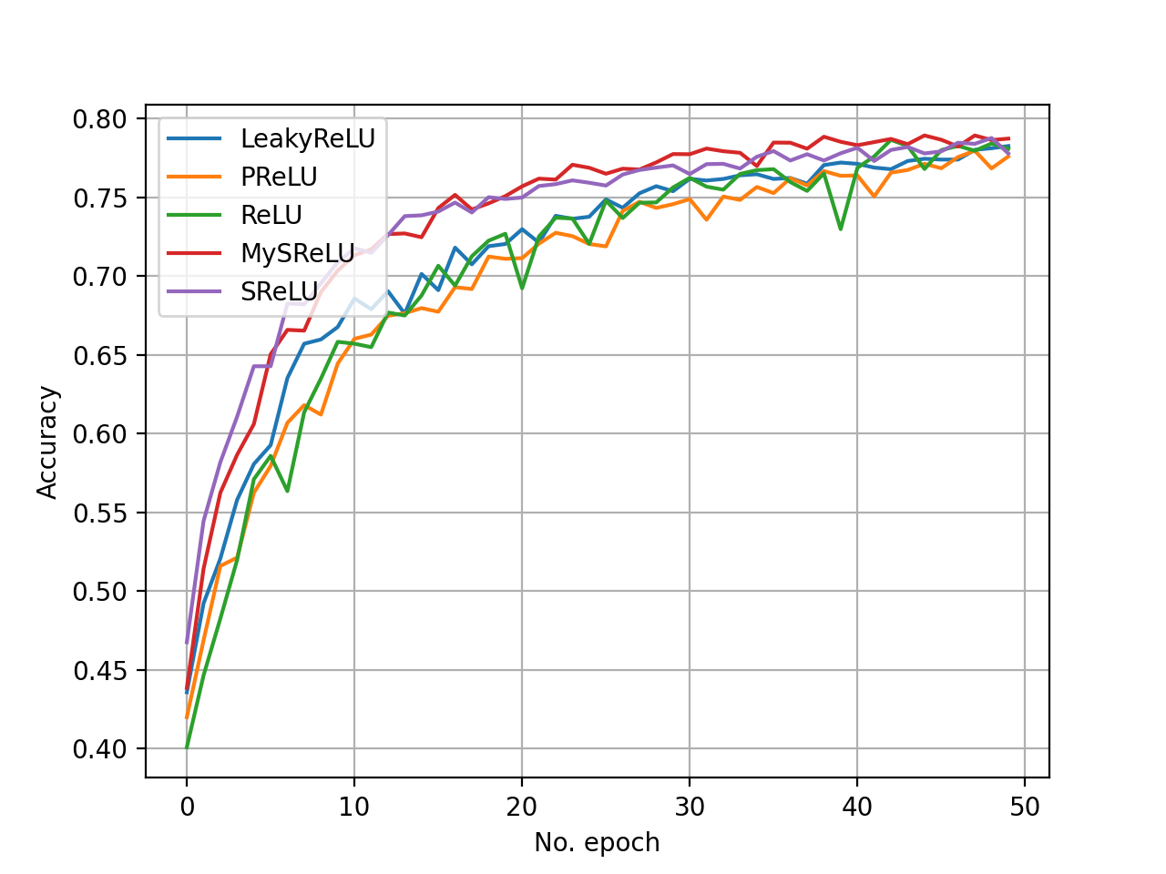
RESULTS: CNN1 ON CIFAR10
ACCURACY: rectified vs exponential activation functions

Slide 19
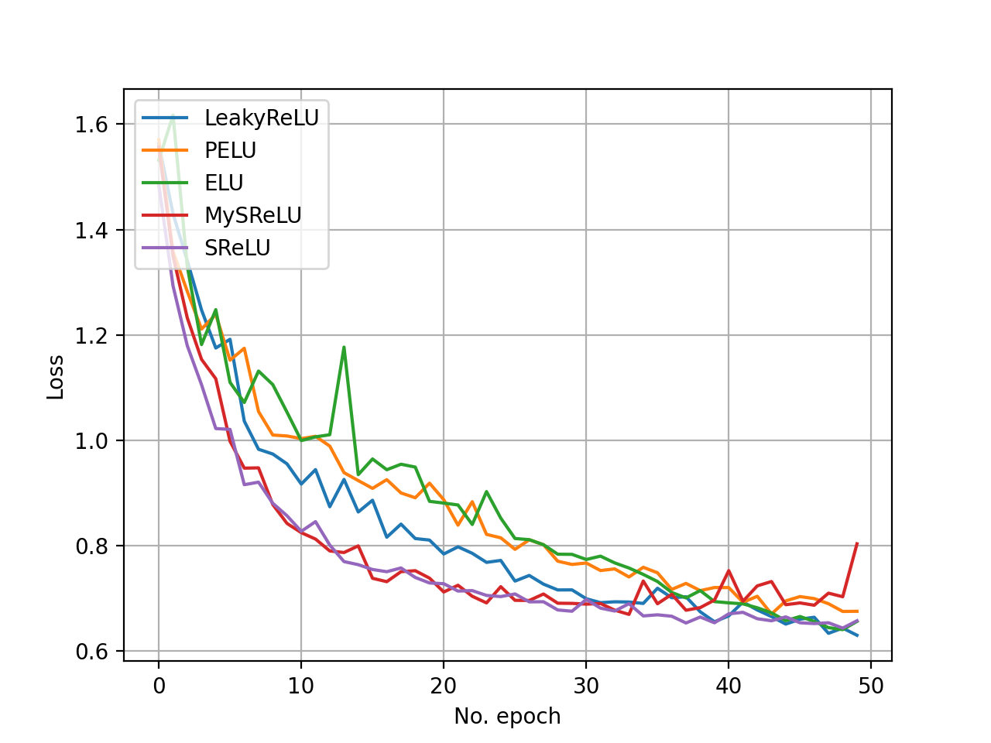
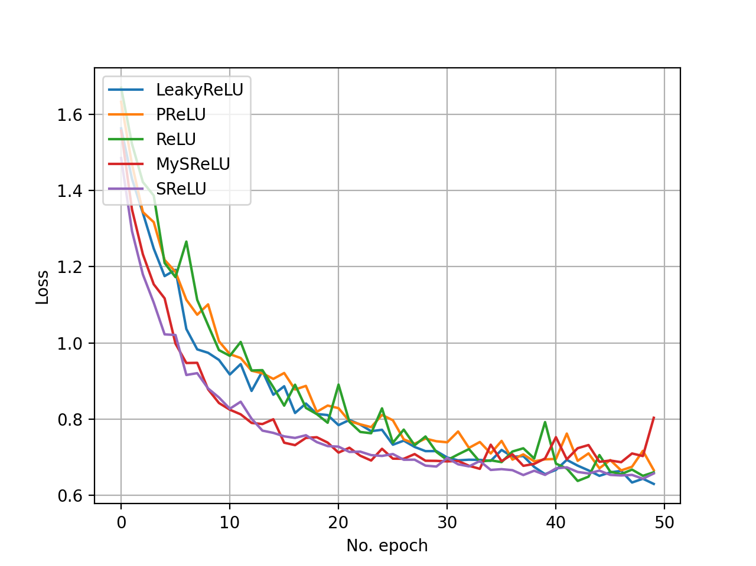
RESULTS: CNN1 ON CIFAR10
LOSS: rectified vs exponential activation functions

Slide 20
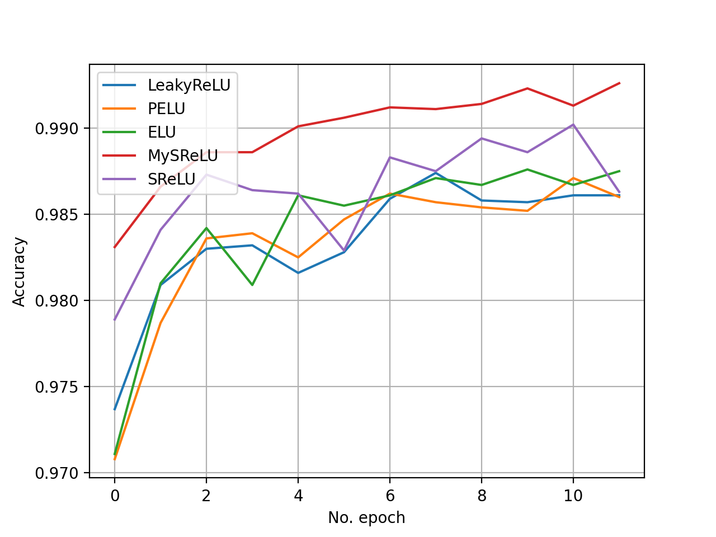
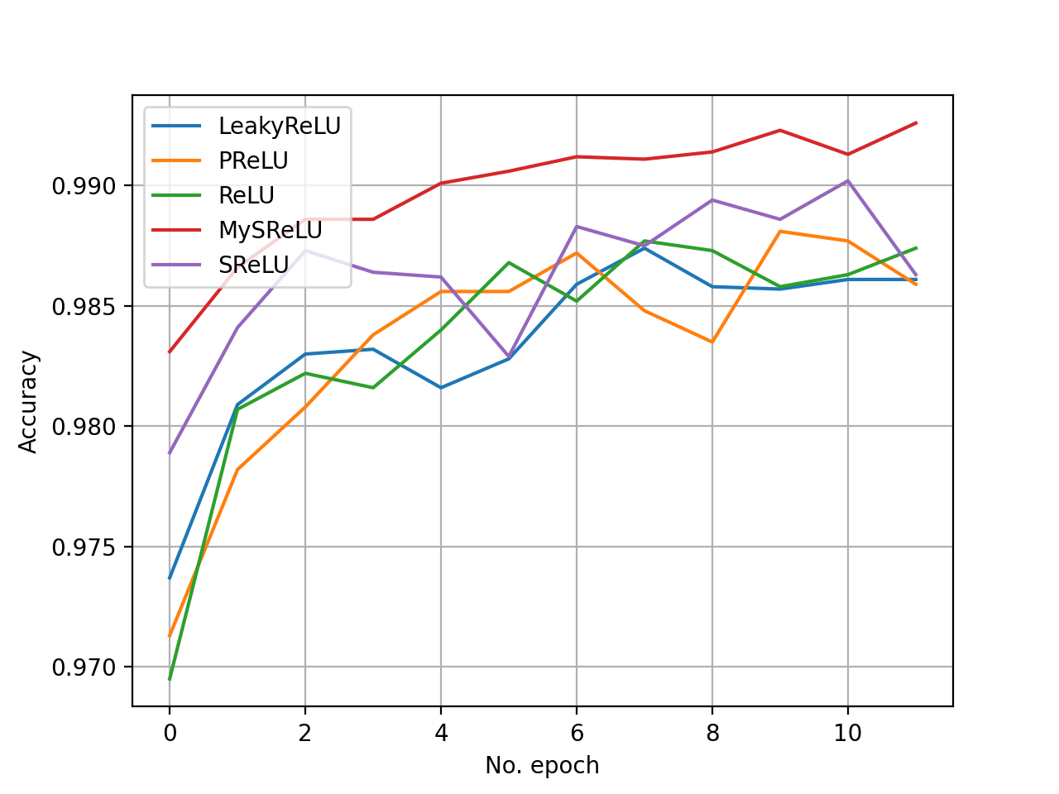
RESULTS: CNN2 ON MNIST
ACCURACY: rectified vs exponential activation functions

Slide 21
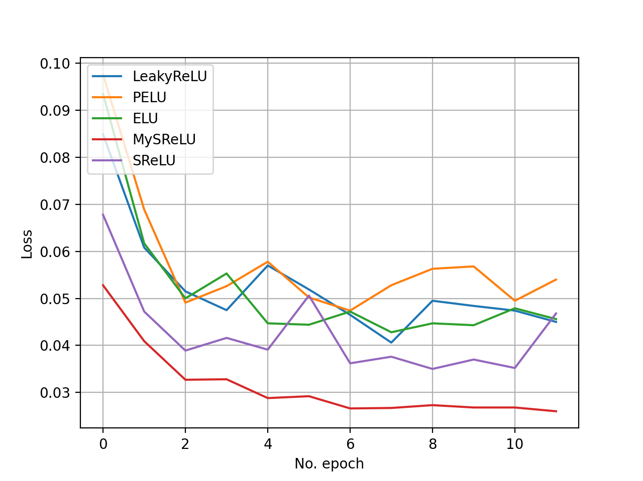
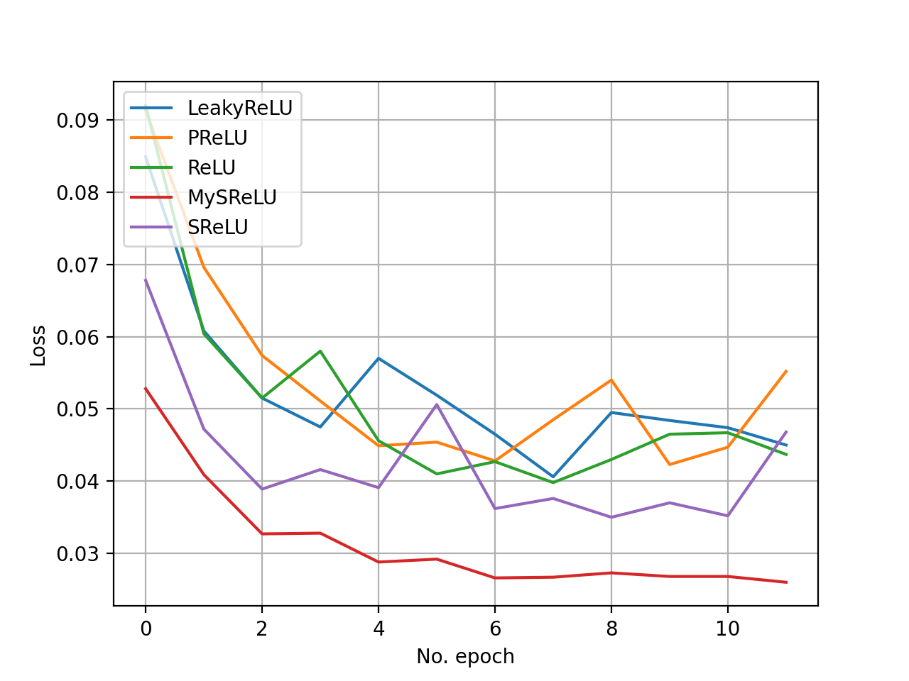
RESULTS: CNN2 ON MNIST
LOSS: rectified vs exponential activation functions

Slide 22
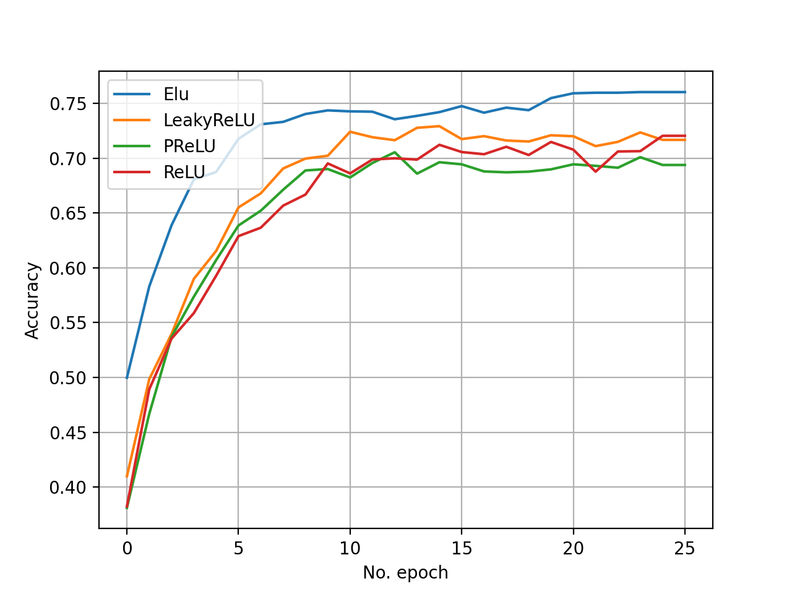
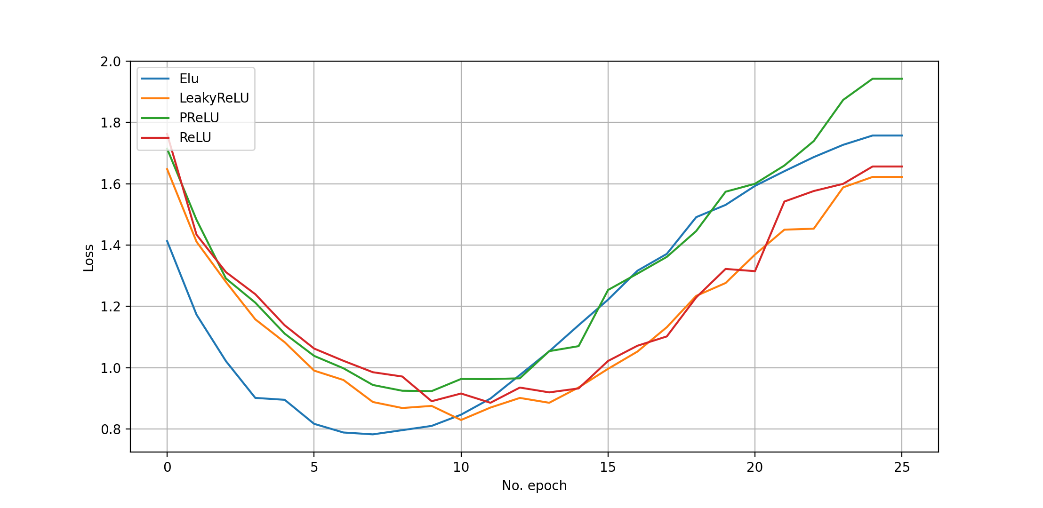
RESULTS: CNN2 ON CIFAR10
ACCURACY & LOSS

Slide 23
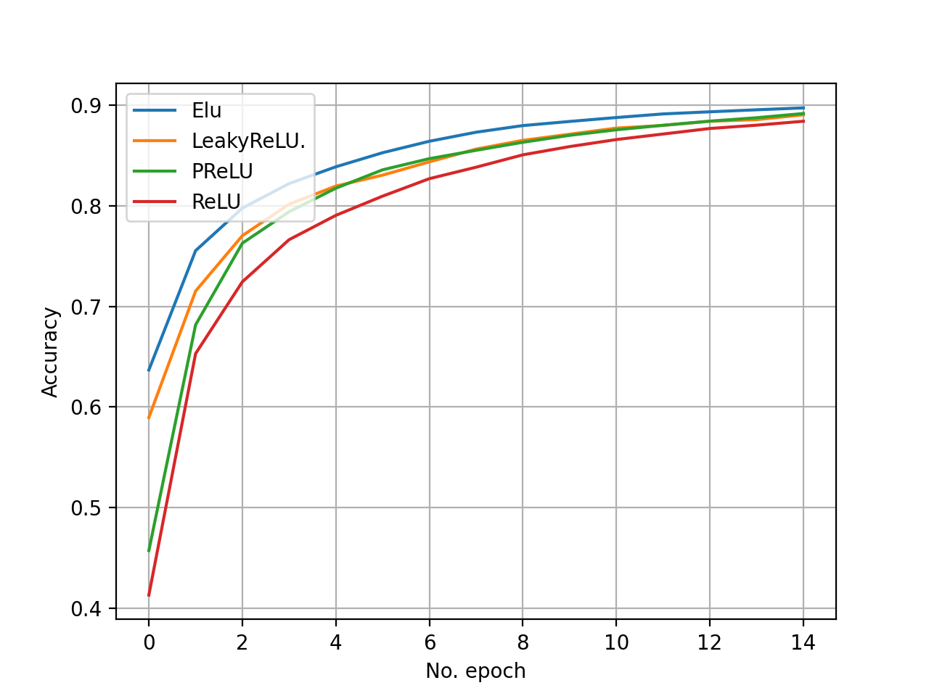
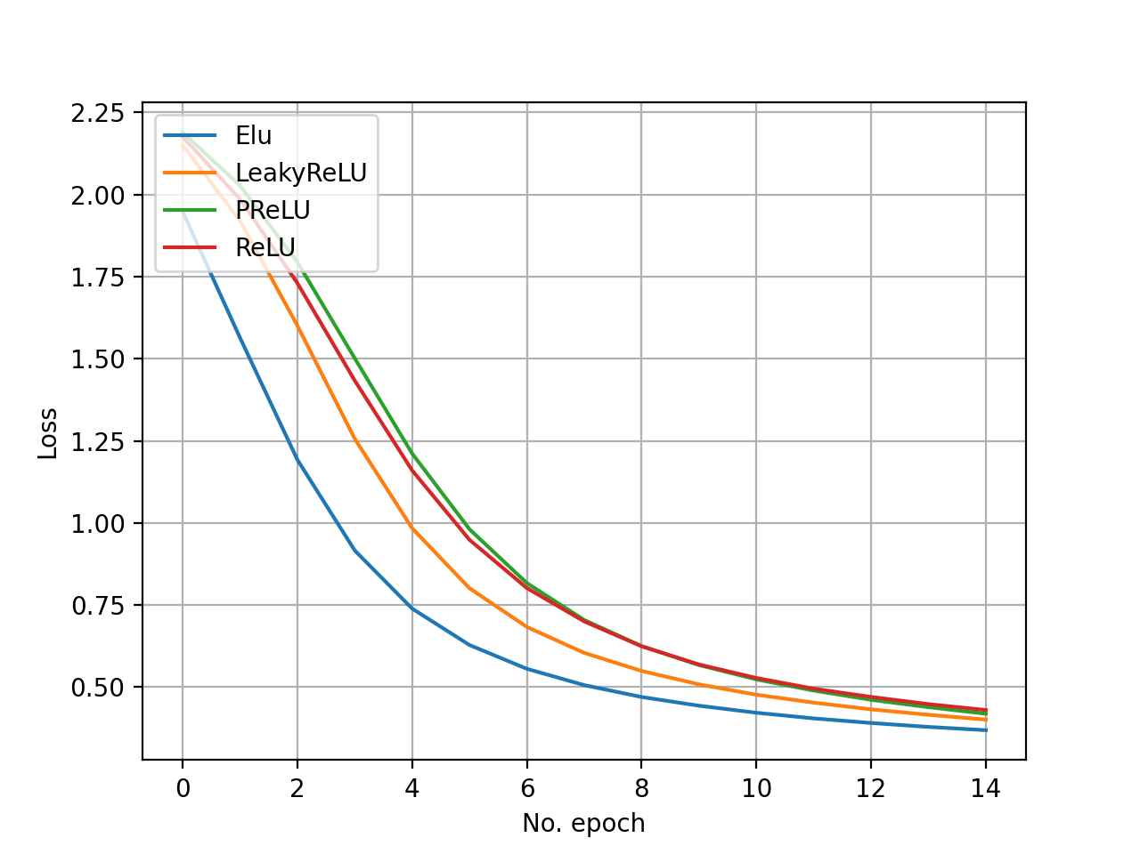
RESULTS: CNN1 ON MNIST
ACCURACY & LOSS

Slide 24


Grazie dell’attenzione

